Slide 1
C300 Final-Year Evaluation
Team ID:
SOI-2020-0049
Team Members:
CHUA KAI ZHEN JOLENE (Leader)
TAN TIAN GAN
YEE HAN YEW
MUHAMMAD SYUKRY SALIM
Project ID:
SOI-2020-2020-0007
Project Title:
TripAdvisor data scrapping and analytics Project

Slide 2
Agenda
Introduction
Project specifications
Business analysis
Project Schedule
Task Allocation & Progress
Data Scraping
Comparison of data scraping tools
Data Scraping Demo
Data Analysis
Text Mining
List of questions
Tableau Demo

Slide 3
Introduction
The problem that we are trying to solve is how raw data from TripAdvisor can be processed into usable information.
The first part of the project is to scrape sufficient data from TripAdvisor.
Cleanse the raw data to prepare it for analysis.
Analyse the processed data with data understanding and come up with business questions to further understand the statistics and what is essential to be presented to tourists.
Find out what is it that a tourist would want to see on TripAdvisor.
Produce credible Visualization Tables and Predictive Model to show insights and useful information for TripAdvisor.

Slide 4
Project Specification
The major task and deliverables of this project is to use the dataset that we have obtained from Tripadvisor and produce usable data that have been processed which are easy to view and understand without much explanation.
The benefits of this project is that we are learning to improve data quality, analysing data and showing data with visualization which are skills in demand in the job market.
The assumptions that were made is that our end deliverable which are the different storyboards would be presented in a TripAdvisor package. This package will be targeted to tourists who are looking to visit Singapore as it covers the 4 important domains of tourism.

Slide 5
Business Analysis
NO businesses can succeed without timely and accurate management information.
The raw data is only valuable if the information and insight are extracted from it to help the business make better decisions.
The valuable information that BI tools provide, enables managers and business owners to optimise planning and to react quickly and efficiently across all decision-making processes.
Our insights are based on the processed data that we derived from the four domains on TripAdvisor which are hotels, attractions, transportation and shopping malls.

Slide 6
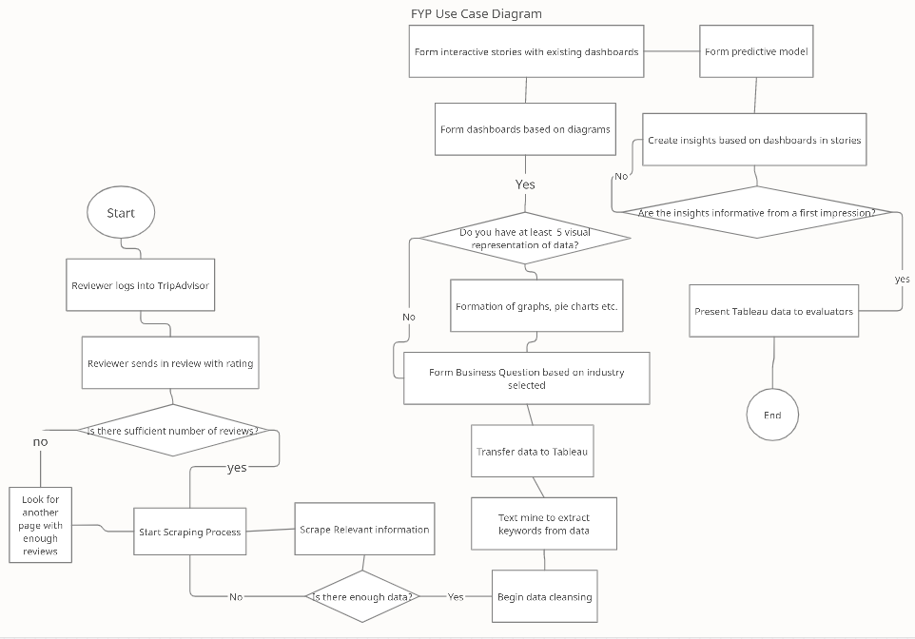
System Design

Slide 7
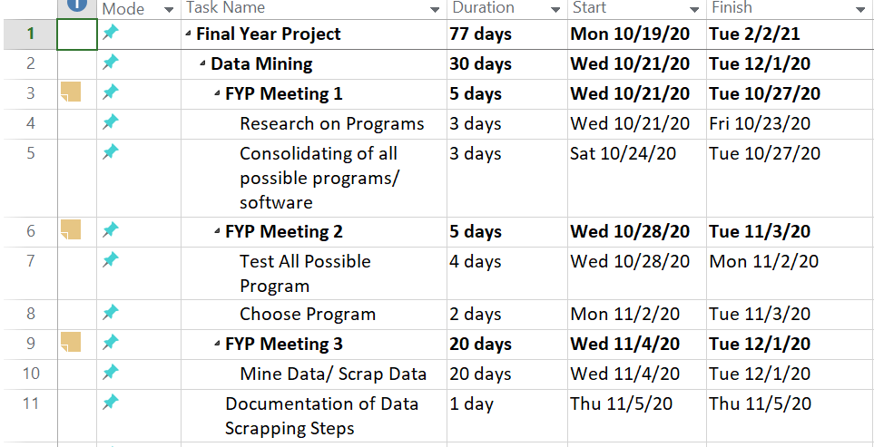
Project Schedule (Week 1-3)

Slide 8
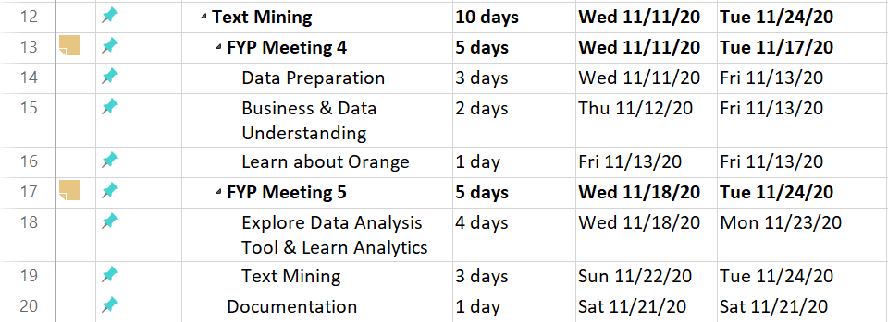
Project Schedule (Week 4-5)

Slide 9
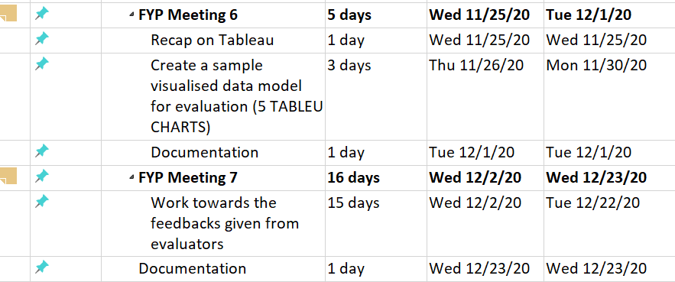
Project Schedule (Week 6-7)

Slide 10
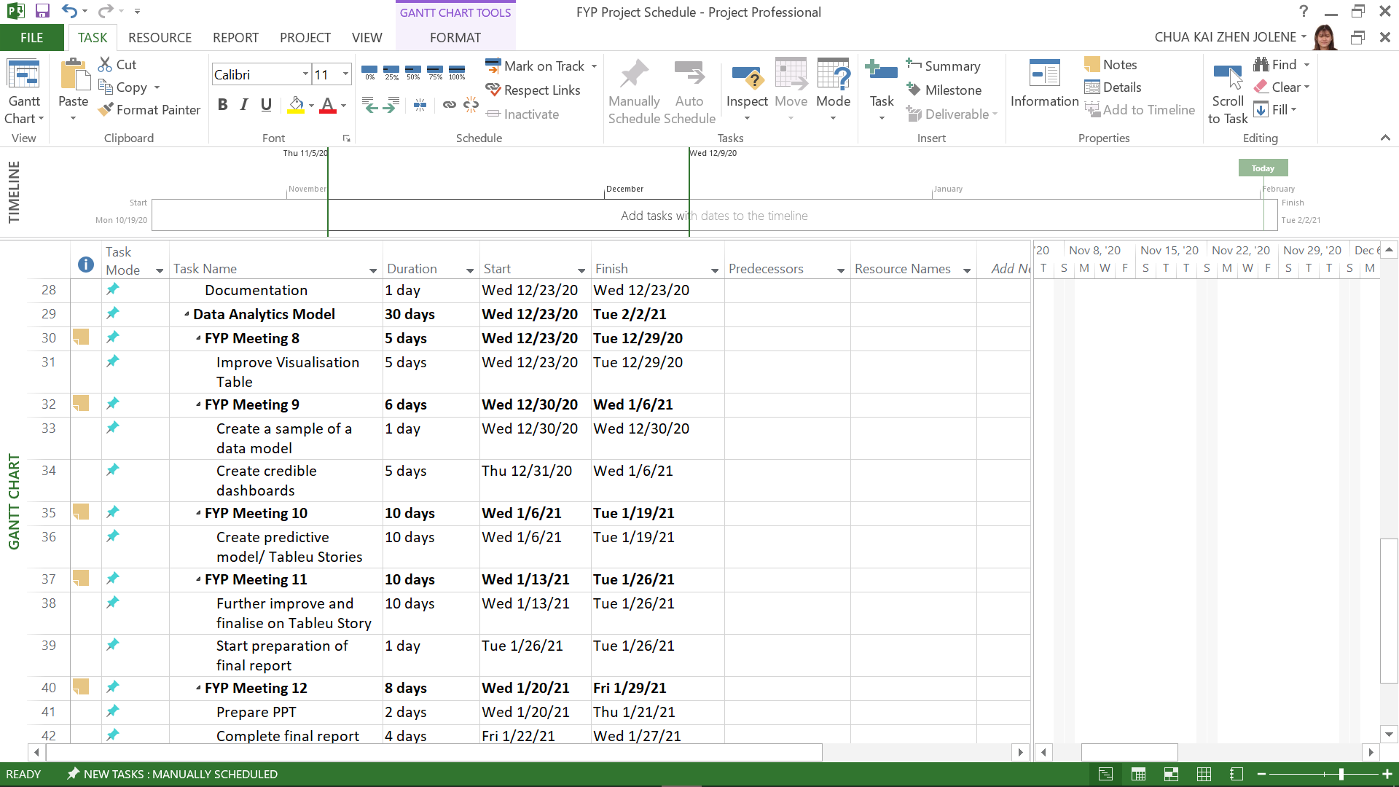
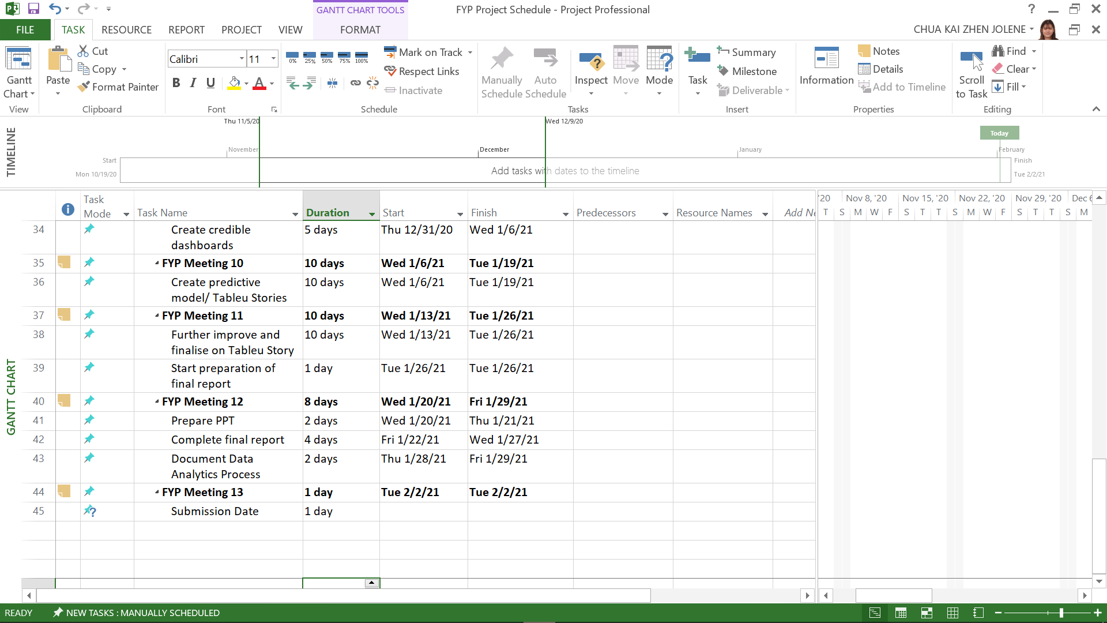
Project Schedule (Week 8-13)

Slide 11


Records of Team Meetings with Supervisor
Name | 21/10 | 28/10 | 4/11 | 11/11 | 19/11 | 25/11 | 16/12 | 06/01 | 13/01 | 20/01 | 27/01
Jolene |  |  |  |  | -
Tian Gan |  |  |  |  | -
Syukry |  |  |  |  | -
Han Yew |  |  |  |  | -

Slide 12
Comparison of Data Scraping Tools
 | PROS | CONS
SCRAPING BOT | Simple dashboard for new users Browser based software, does not take up space on computer | 5 Concurrent Requests JS Rendering (Headless Chrome) Premium Proxies RAW HTML
UIPATH | Free to use for an unlimited period of time Very clean user interface, easy to navigate | Installation and setup is fairly difficult as the tutorial video is outdated and most of the updated software does not match with the video Limitations are unclear as compared to other softwares

Slide 13
Comparison of Data Scraping Tools
 | PROS | CONS
DATA MINER PRO | Free to use Includes a step by step procedure on helping the user to identify what data is required Quite simple to use Allows user to save the compiled data to MS Excel The software allows user to run their own javascript | Requires some knowledge of HTML for better breakdown of the data. At times, the data you want to scrap is not scrapable but this is rare
HELIUM SCRAPER | Does not require programming skills Use friendly point-and-click interface Easy to use Enables the user to scrap more than one website | More advanced as compared to Data Miner It is pay-to-use after a 10 day free trial

Slide 14
Comparison of Data Scraping Tools
 | PROS | CONS
PARSEHUB | No coding required user is able to use the program just with clicks of the mouse (easy to use) There is a free plan | 200 pages in 40 mins Data retention for 14 days 200 pages per run Only able to save 5 configurations Keeps crashing when testing on TripAdvisor website
WEBHARVY | Very easy to use Easy to organise Able to select the information that we need for the project. | Need to pay after a 15 day trial It is limited to capture only 2 pages of data from web sites during the trial

Slide 15
Comparison of Data Scraping Tools
 | PROS | CONS
OCTOPARSE | No coding required user is able to use the program just with clicks of the mouse (easy to use) The mined results are accurate Unlimited pages per crawl Able to run 2 concurrent mines per local run | Takes a long time to mine the data Only 10,000 lines of data per export Only able to save 10 configurations

Slide 16
Why did we chose Data Miner Pro ?
Would not keep have error/running into problem like other software
Free to use with limitations of 500 pages per account
Includes a step by step procedure on helping the user to identify what data is required
Fairly simple to use
Allows user to save the compiled data without much process to MS Excel
The software allows user to run their own javascript if needed

Slide 17
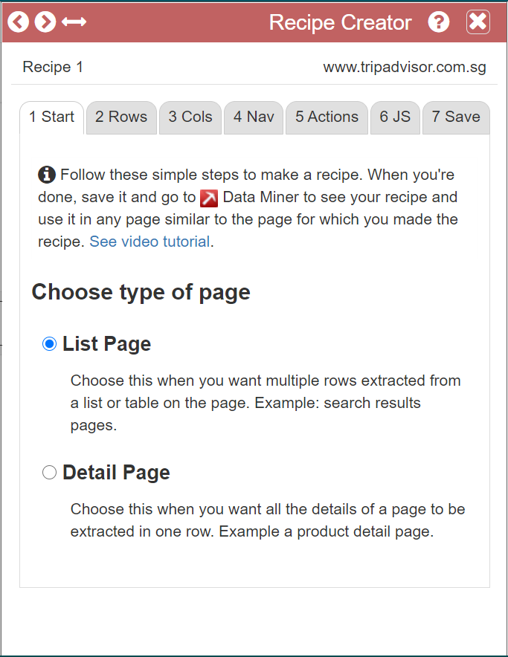
Data Scraping Demo
First you will need to create a recipe.
Then you will need to choose the type of page that you are scrapping.
Since the Reviews are a List Page we will go ahead and select that.

Slide 18
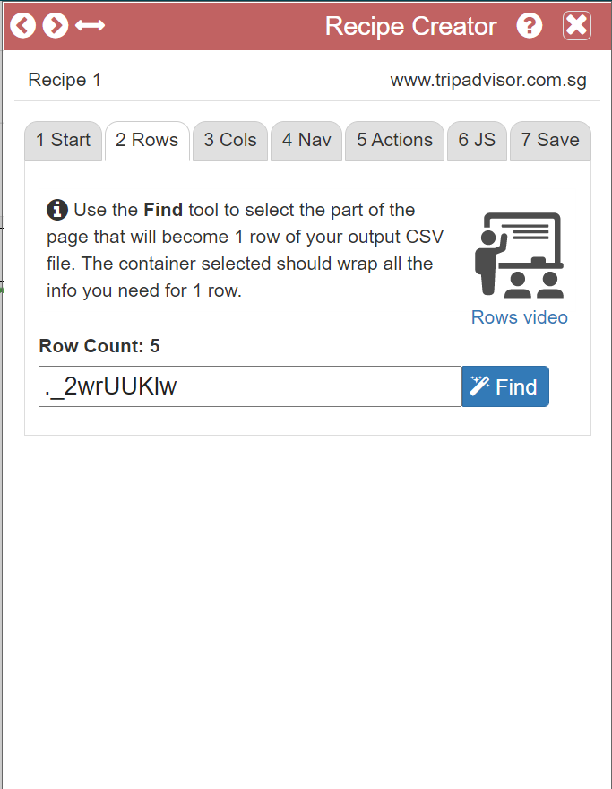
Data Scraping Demo
Next select the rows of data that you will like to scrape by clicking on Find then hover over the row that you will like to scrape and press SHIFT.

Slide 19
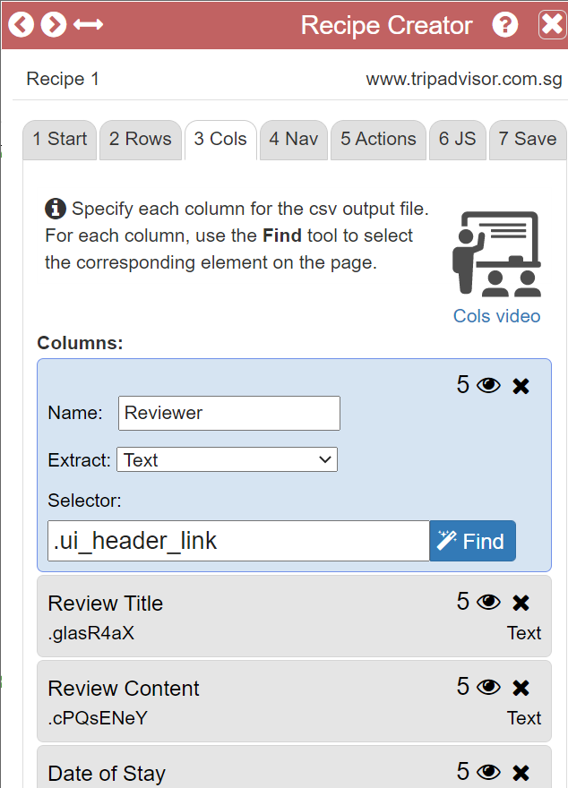
Data Scraping Demo
After that you will need to select the columns that contains the data you want in the file.
For Reviewer, Review title and Review Content we have tasked the program to extract the text since that is what we need from those columns

Slide 20
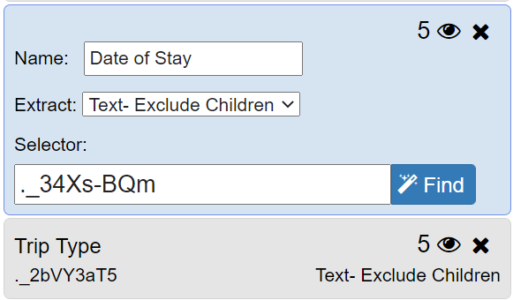
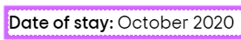
Data Scraping Demo
For Date of Stay and Trip Type we have selected the “Text - Exclude Children” as it will then not include the header like “Date of Stay” and it will just take in “October 2020”

Slide 21
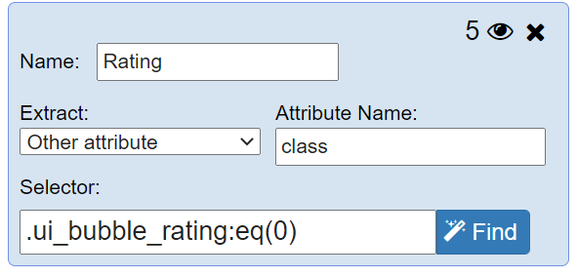
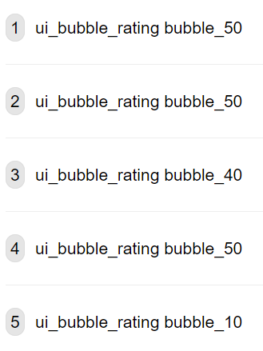
Data Scraping Demo
For Rating column we will need to select the “Other Attribute” and in the attribute name type “class” this will tell the program to extract the class from the line of code which is “ui_bubble_rating”

Slide 22
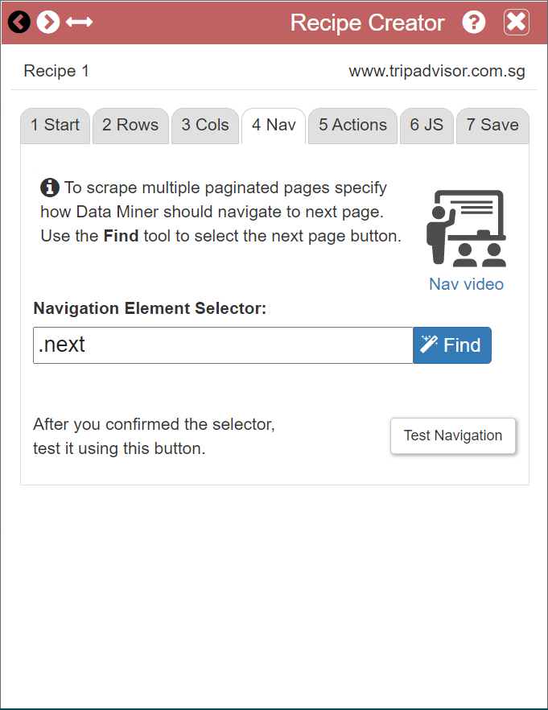
Data Scraping Demo
The next step is to tell the program how it is to get onto the next page, to do so we will need to click “Find” and hover over the next button and press SHIFT.

Slide 23
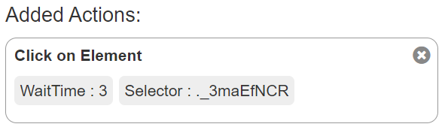
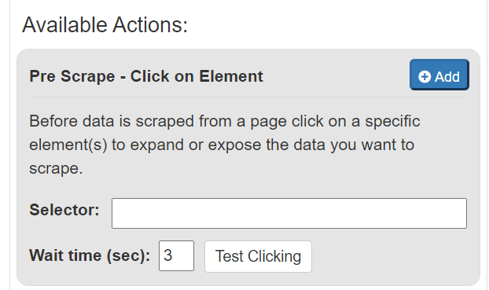
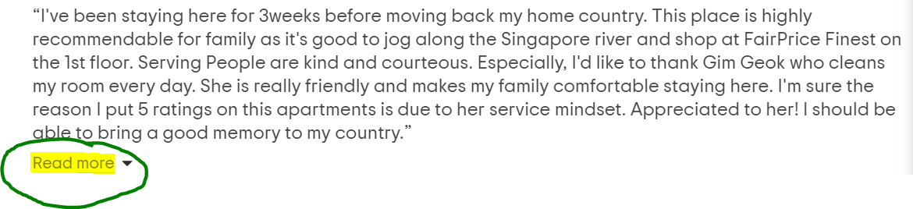
Data Scraping Demo
After the pagination is done, we will need the program to click a “READ MORE” button to get the “Date of Stay”, etc.
To do so we will need to get the selector and paste it into the click on element box then click on add

Slide 24
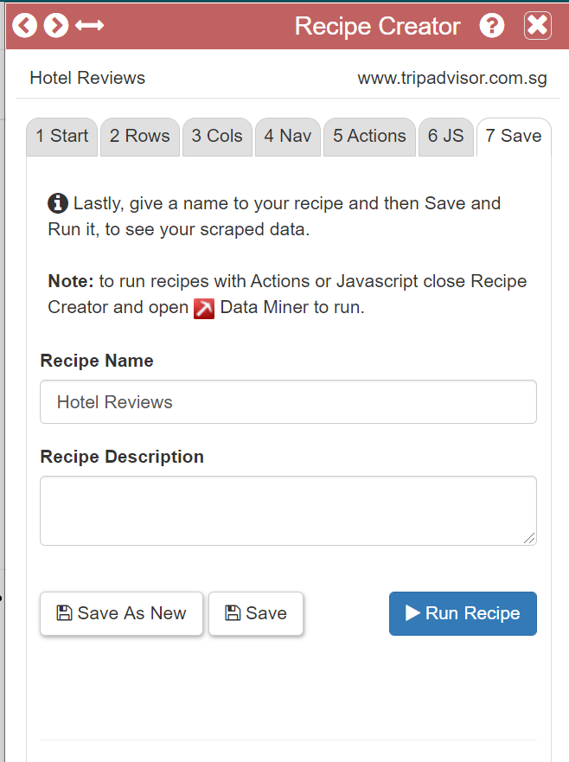
Data Scraping Demo
After that name your recipe and then save it so you are able to use it on another page on the same website

Slide 25
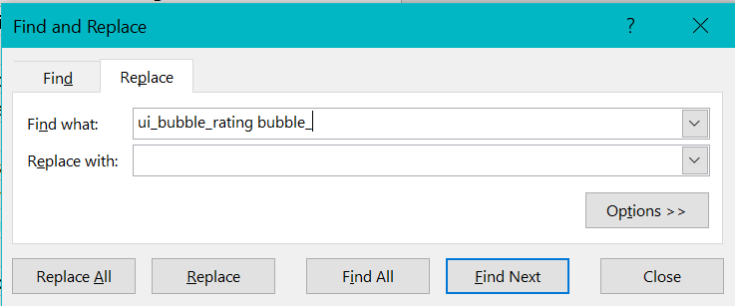
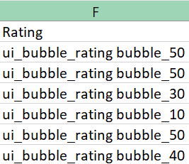
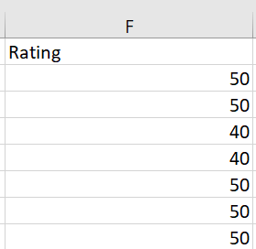
Data Cleansing
We used the tools in Excel to cleanse the data that we have
First we used the Find and Replace to remove the line of code from the rating so it will be just the numbers

Slide 26
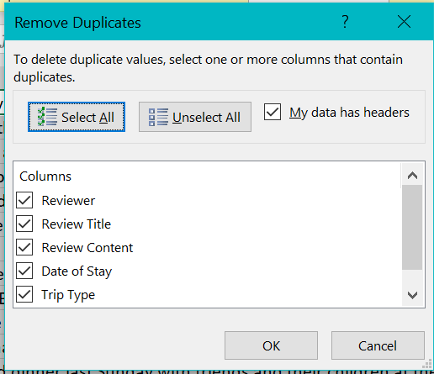
Data Cleansing
Next we used the Data cleansing to remove any duplicates of date that we had so the data that we were looking through was accurate

Slide 27
Transportation Data Set (Galvin)
Total data scraped: 22550 rows of data.
Extracted data consists of : Username, date of visit, review title, review and review bubble rating.
Have 16 different sets of data, Aeroline Service Centre Singapore, Avenue Link Transport Group, Brothers Team- Nepal & Bhutan Travel Specialist, eLimo, Maxi-Cab Singapore, MRT, MST Transport, MyTrip Transport Services, Nas Tours, Offbeat Tours, Prime Aces Limousine, Rui Transport Services, Sarah Lev, SBS, Singapore Cable Car, Singapore River Cruise

Slide 28
List Of Questions (Transportation)
1. How did the Coronavirus affect SMRT and how well SMRT will perform in the future?
2. Is taking the bus or train more popular among commuters? Are bus fares cheaper compared to train fares?
3.Do people enjoy the Singapore River Cruise or the Singapore Cable Car more? How much are the respective attractions and how did Covid-19 affect them in 2020?
4.Which private transport is the most popular and how did Coronavirus affect them?
5.The different tour groups features and prices. Which one is the most popular?

Slide 29
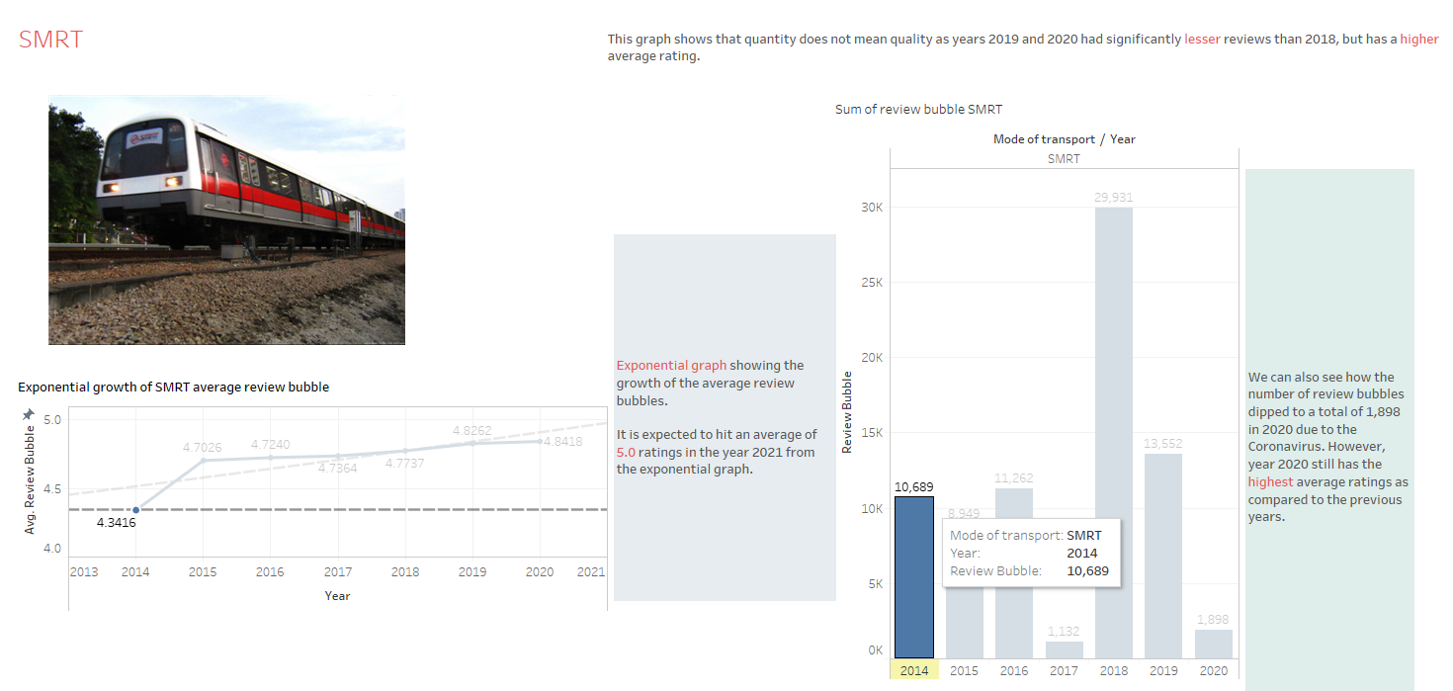
How did the Coronavirus affect SMRT and how well SMRT will perform in the future?

Slide 30
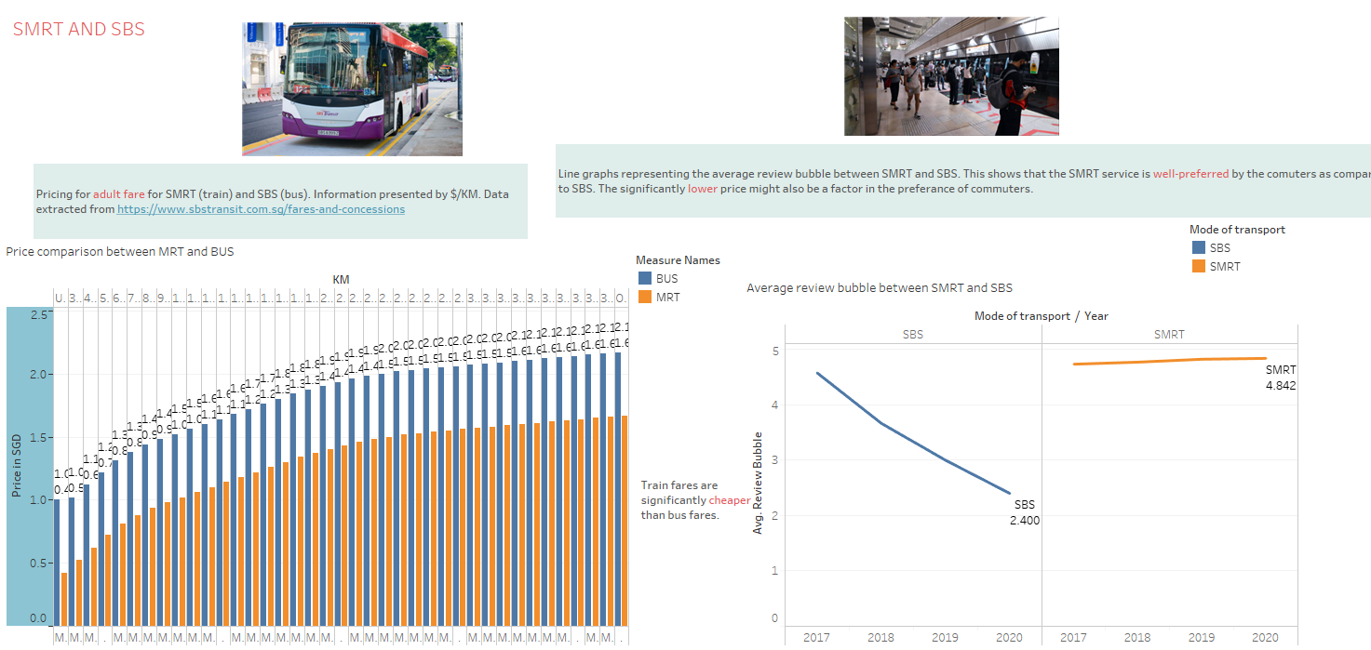
Is taking the bus or train more popular among commuters? Are bus fares cheaper compared to train fares?

Slide 31
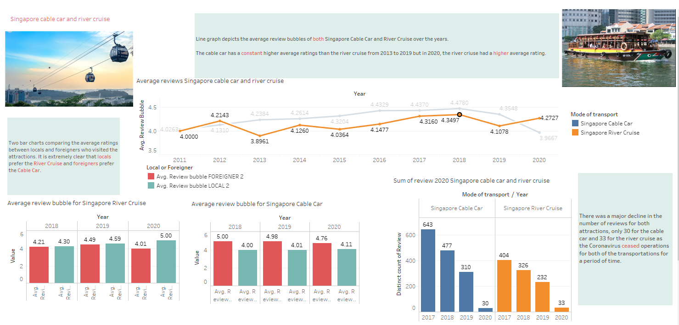
Do people enjoy the Singapore River Cruise or the Singapore Cable Car more? How much are the respective attractions and how did Covid-19 affect them in 2020?

Slide 32
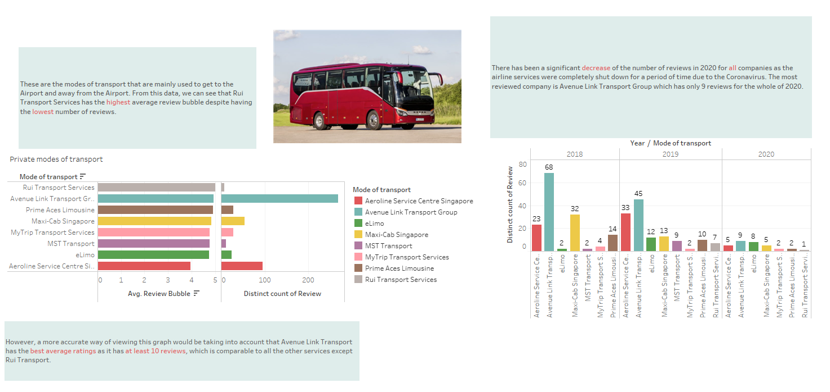
Which private transport is the most popular and how did Coronavirus affect them?

Slide 33
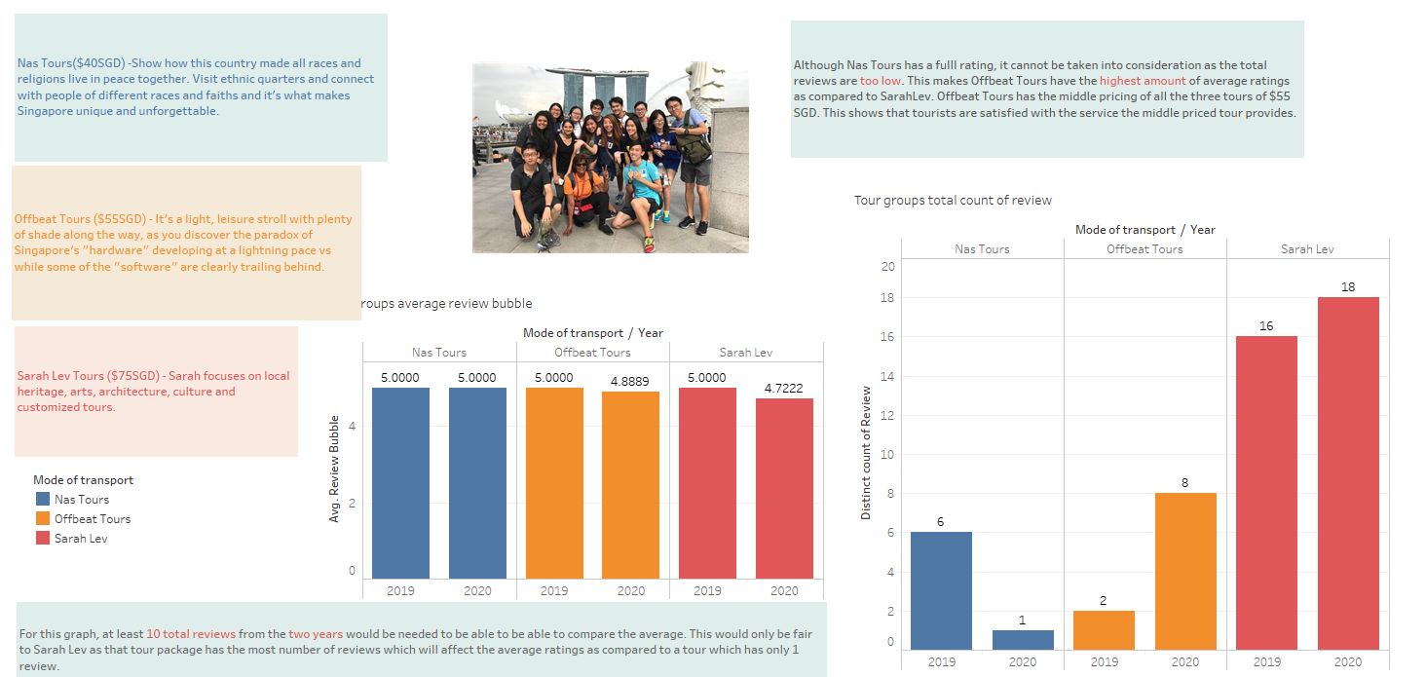
The different tour groups features and prices. Which one is the most popular?

Slide 34
Shopping Malls Data Set (Jolene)
Total shopping malls in Singapore as of August 2020 is 171.
Extracted shopping malls with minimum requirement of 50 reviews on TripAdvisor.
Took the maximum reviews possible for each mall to fulfill the target of 10k rows when combined.
Combined data set scrapped as of now is 11,679 rows of reviews.

Slide 35
List Of Questions (Shopping Malls)
Do the number of reviews determine the shopping mall ratings ?
Does the location of the mall affects the number of visitors ?
Which shopping malls should tourists visit and shop at in Singapore ?
Which shopping malls should tourists be avoiding in Singapore ?
I would like to see the star ratings for each shopping malls.
Is there a relationship between Shopping Malls & Hotels ?
Which area of Singapore should I stay to get the most out of the shopping malls ?

Slide 36
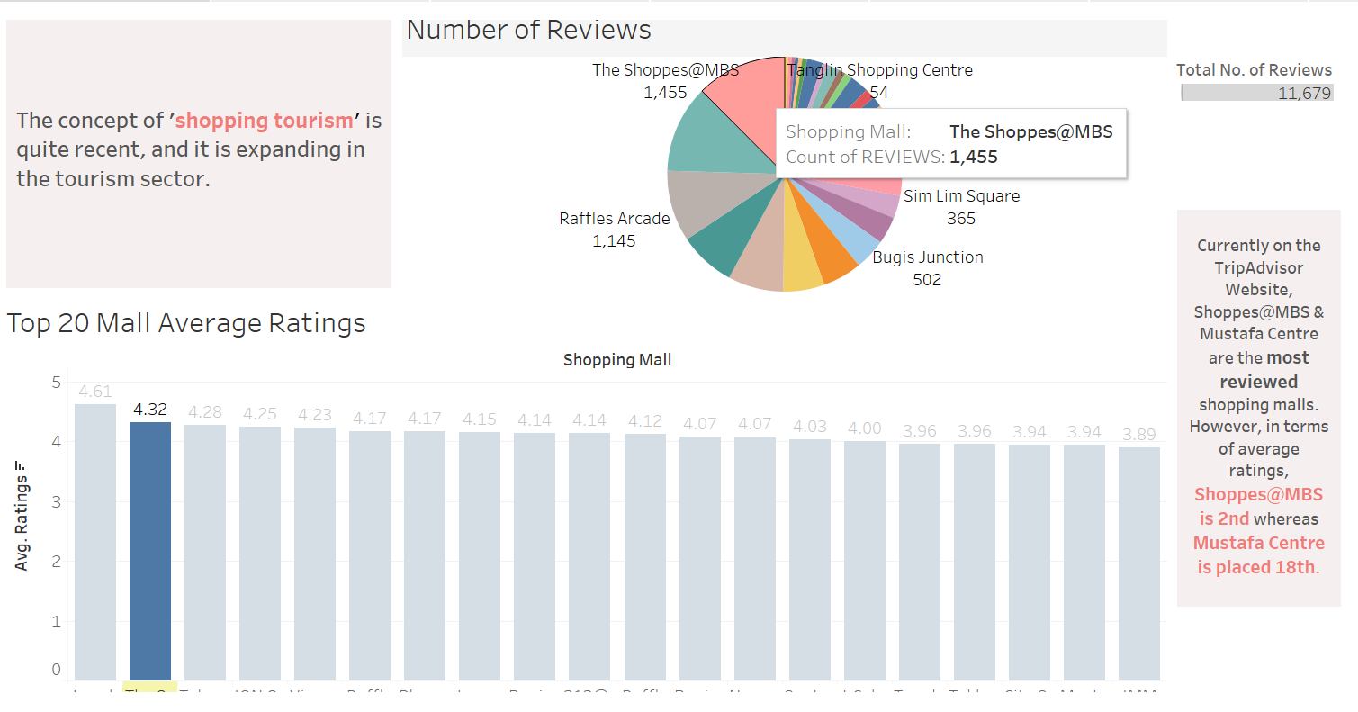
Do the number of reviews determine the shopping mall ratings ?

Slide 37
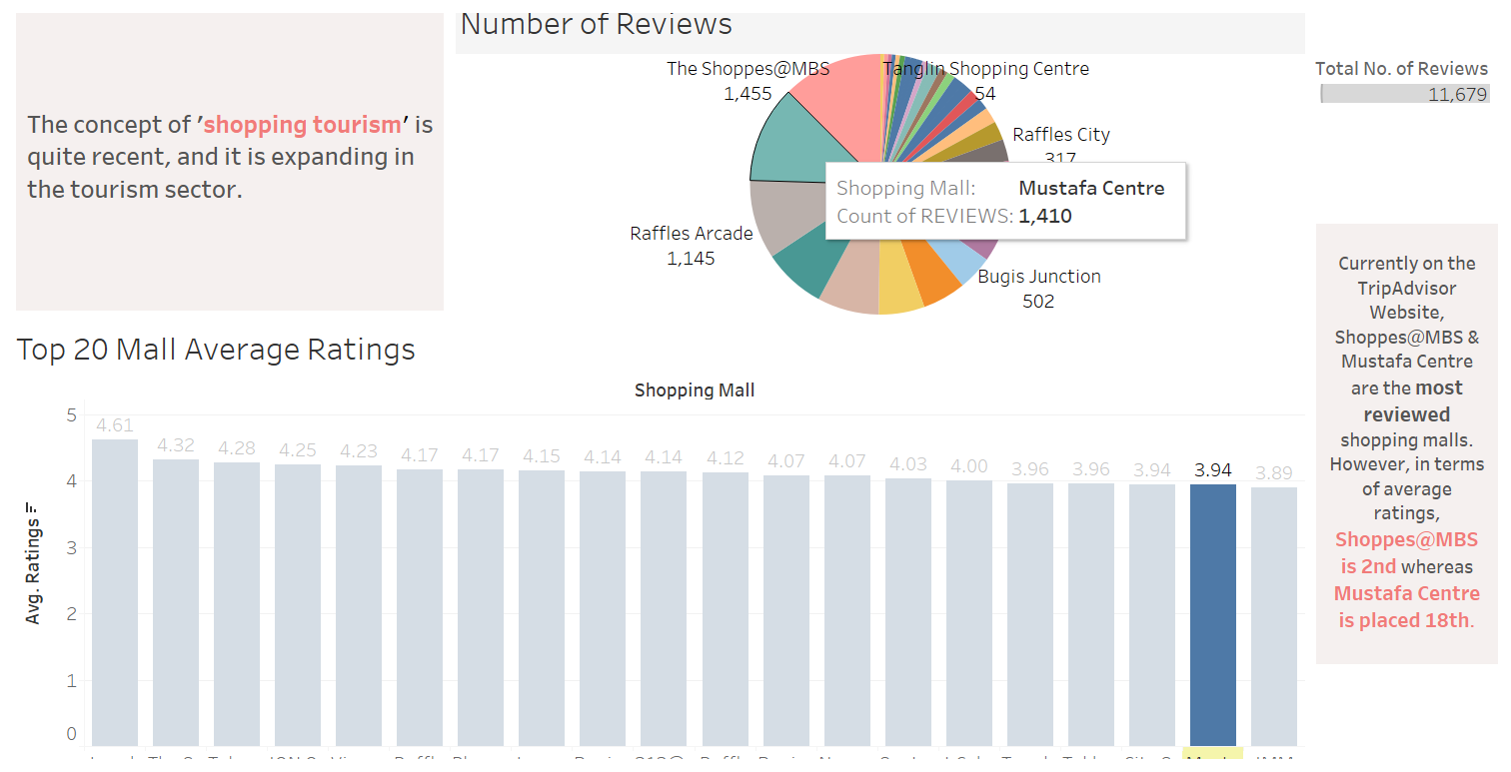
Do the number of reviews determine the shopping mall ratings ?

Slide 38
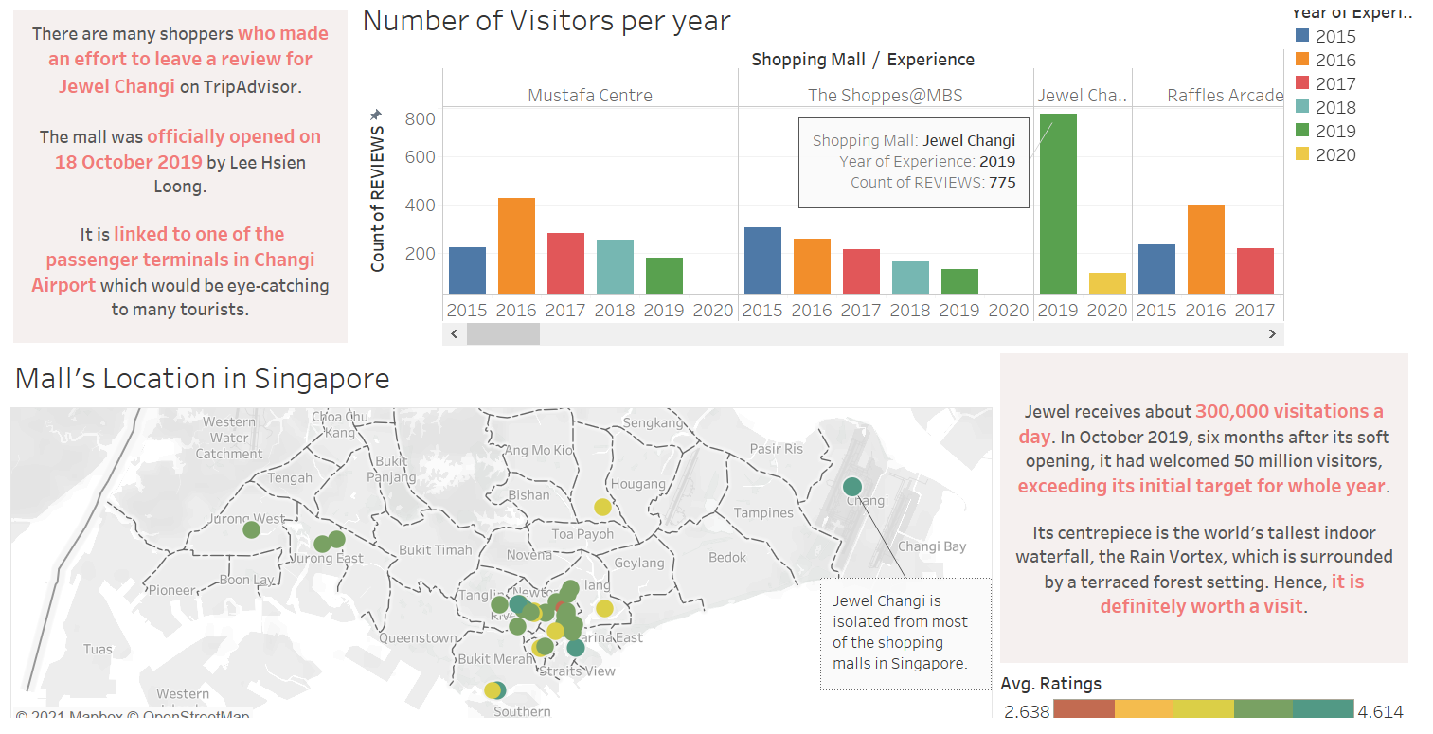
Does the location of the mall affects the number of visitors ?

Slide 39
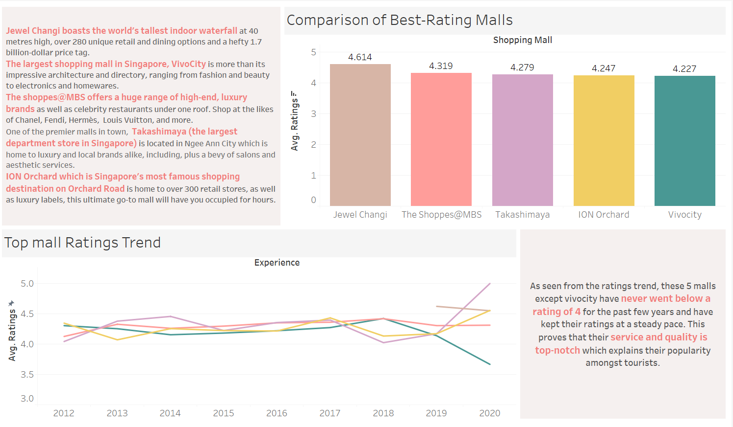
Which shopping malls should tourists visit and shop at in Singapore ?

Slide 40
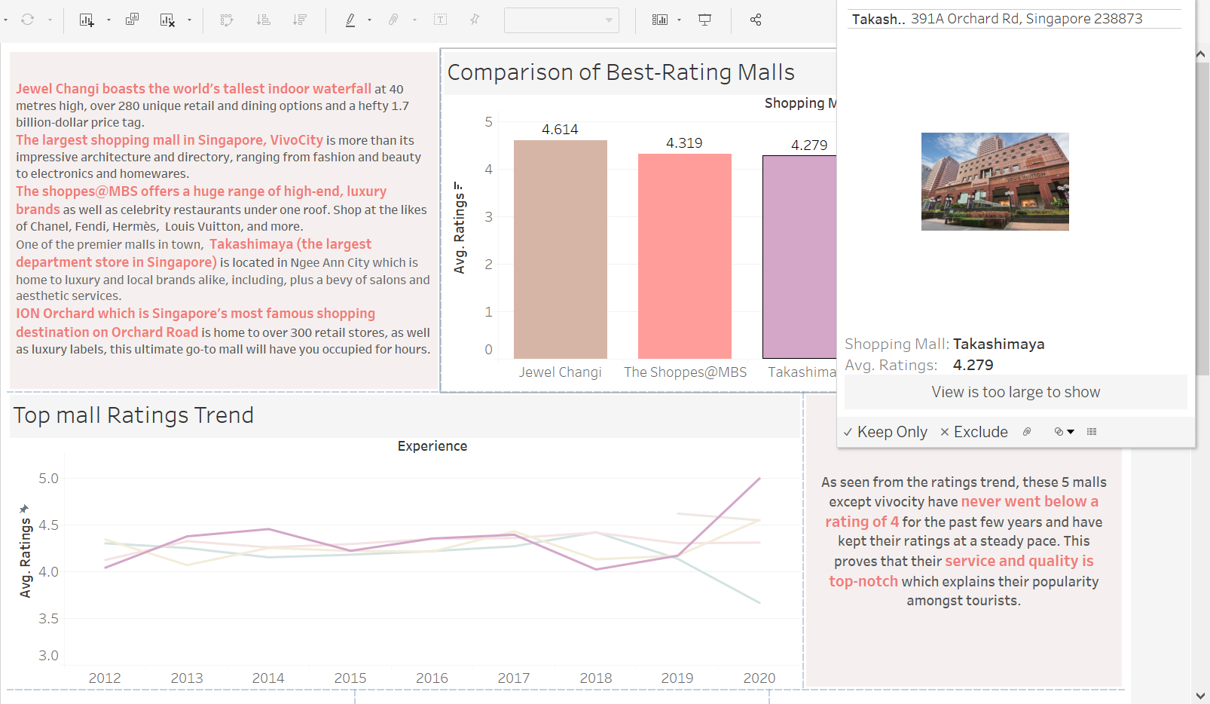
Which shopping malls should tourists visit and shop at in Singapore ?

Slide 41
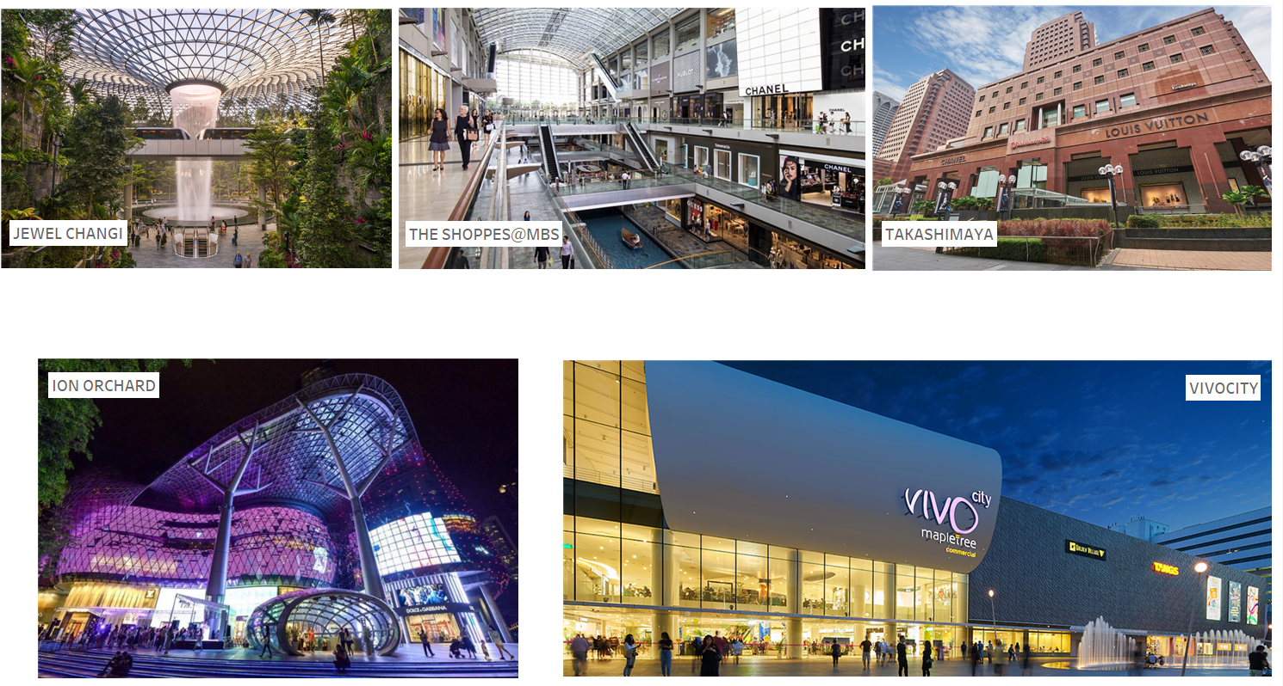
Which shopping malls should tourists visit and shop at in Singapore ?

Slide 42
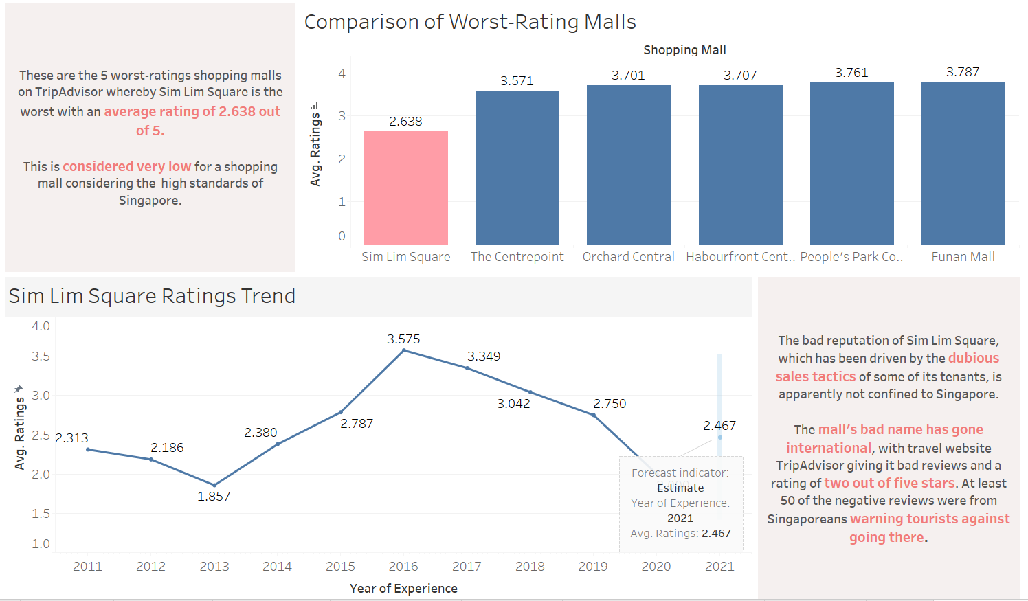
Which shopping malls should tourists be avoiding in Singapore ?

Slide 43
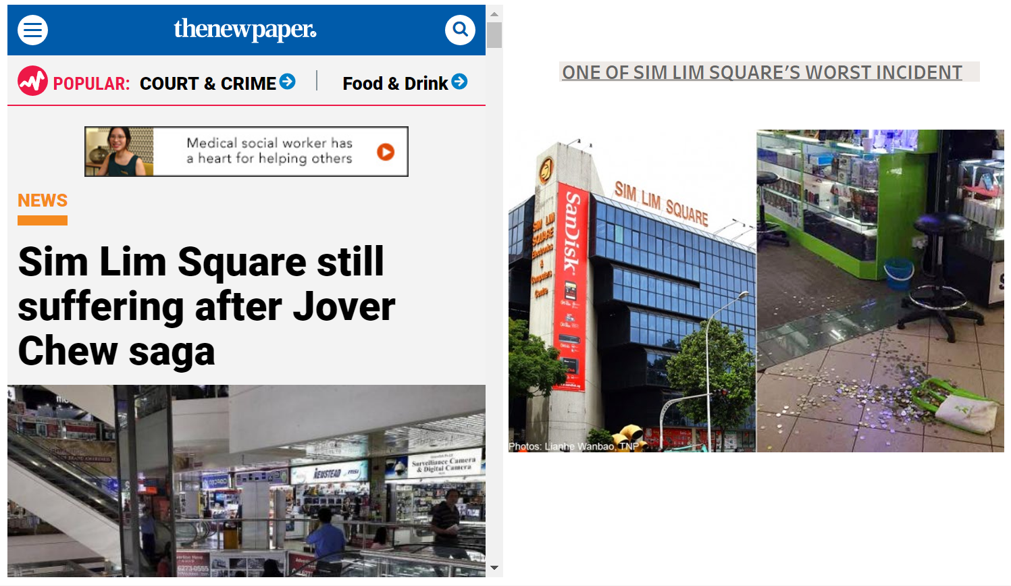
Which shopping malls should tourists be avoiding in Singapore ?

Slide 44
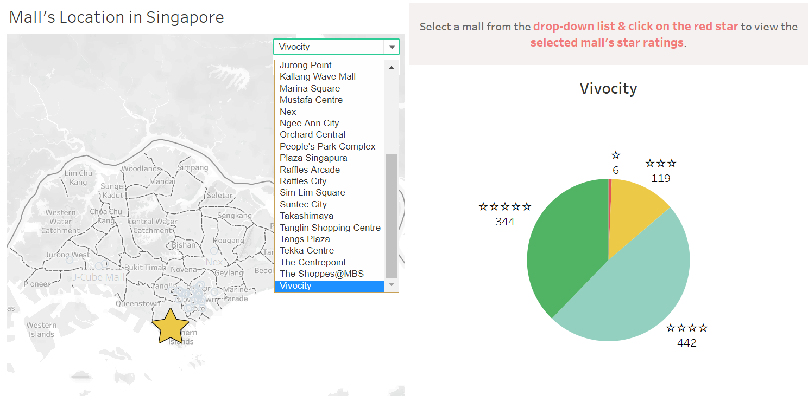
I would like to see the star ratings for each shopping malls.

Slide 45
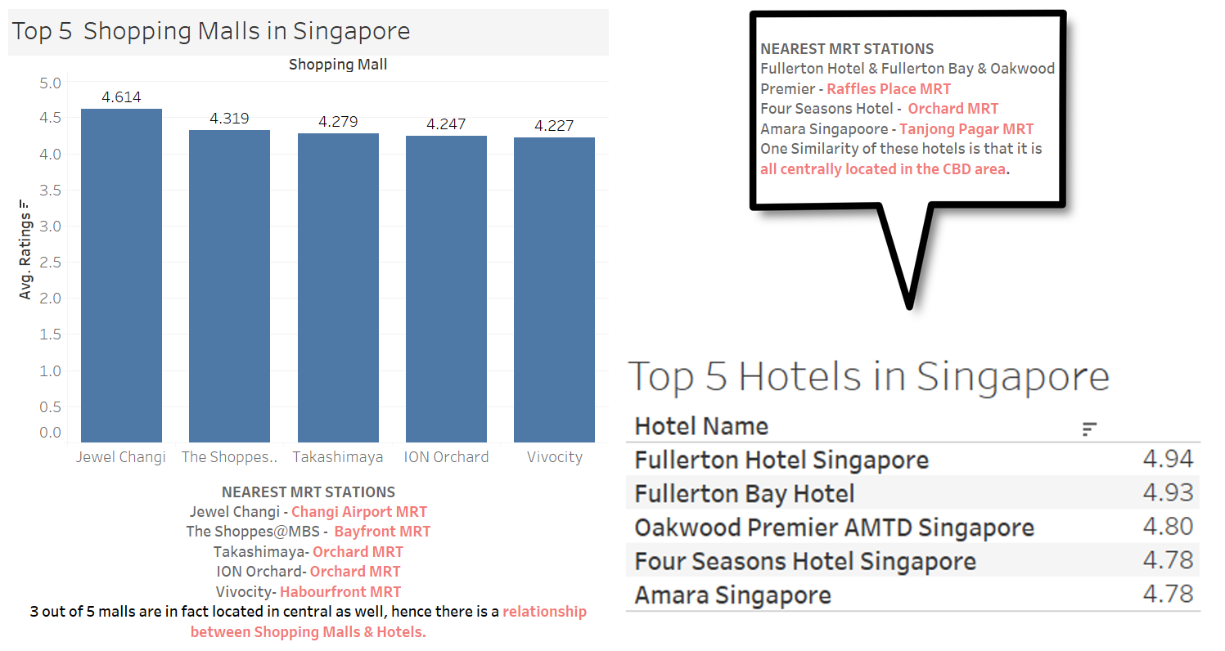
Is there a relationship between Shopping Malls & Hotels ?

Slide 46
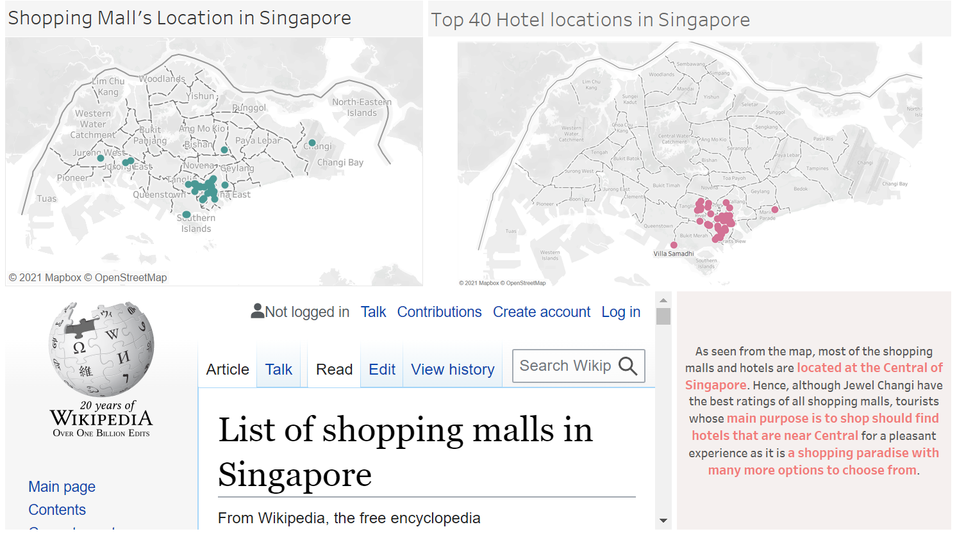
Which area of Singapore should I stay to get the most out of the shopping malls ?

Slide 47
Hotel Data Set (Tian Gan)
Top 40 traveller choice hotels on TripAdvisor
50 pages of reviews on reviews that contain the trip type
Total about 250 reviews per hotel
Combined data set has 10,075 rows of data after data cleansing (remove duplicates)

Slide 48
Data explanation
Reviewer - Username of the person that left the review on the hotel
Review title - Title of the review
Review Content - Review Content on the user has left on the Hotel
Date of Stay - The Month and Year of when the user stayed at the Hotel

Slide 49
Data explanation (continuation)
Trip Type - The category of the trip that the user has taken when they went to visit the hotels
Hotel Name - Name of the Hotel
Address - The address of the Hotel
Cords 1 - Longitude of where the Hotel is located on the global map
Cords 2 - Latitude of where the Hotel is located on the global map

Slide 50
List Of Questions (Hotels)
What Hotel should we pick for the Category of Trip Type that I am going?
What are the recent comments of the Hotel that was chosen?
Which hotels are recommended?
What hotel should we go to for a cheap Staycation?
Which hotel should I choose if I wanted to go the best attraction in Singapore?
Does the number of visitors affect the rating of the Trip Type?

Slide 51
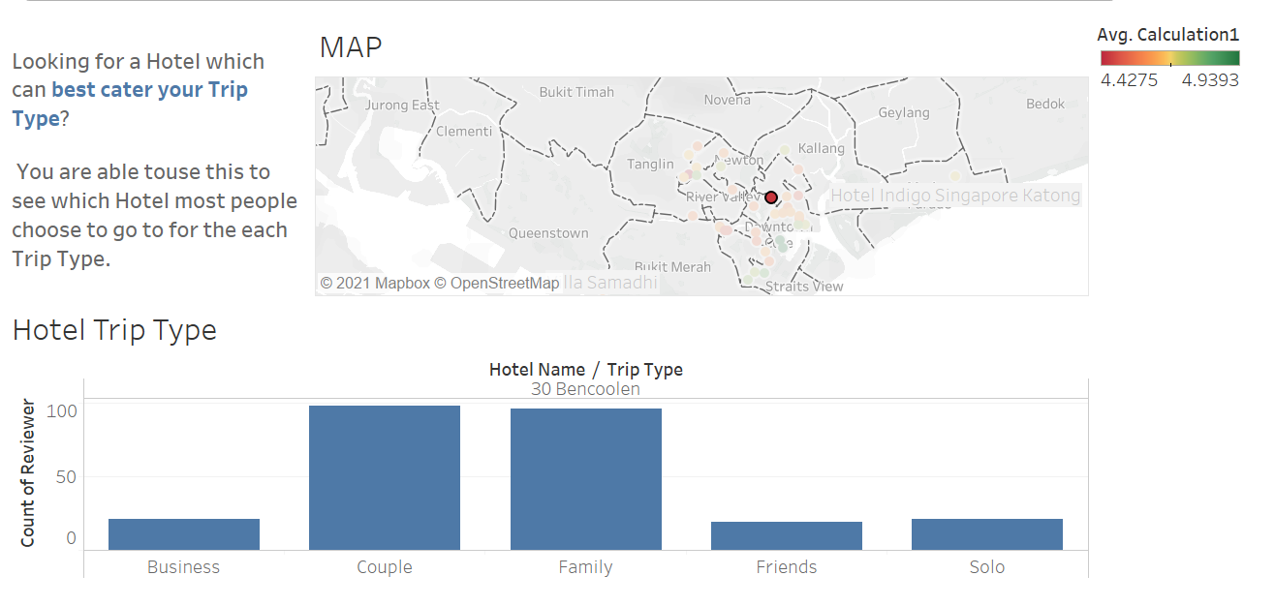
What Hotel should we pick for the Category of Trip Type that I am going?
This shows the Average Rating of the top 40 Traveller Rated Hotels in Singapore
This will shorten this list for travellers to choose the hotel they would like to pick
They will also be able to see which hotel will best cater to their trip type

Slide 52
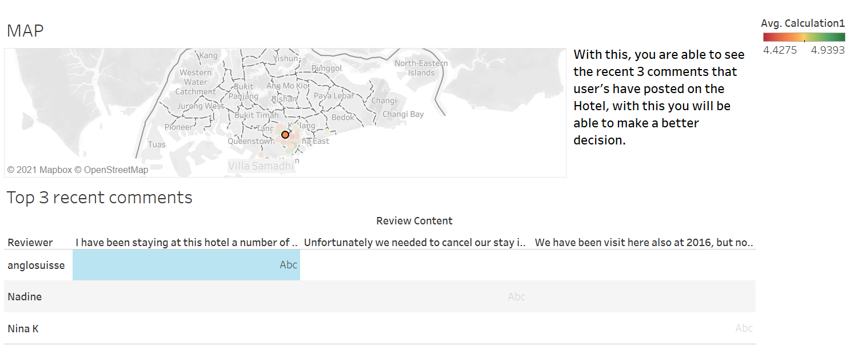
What are the recent comments of the Hotel that was chosen?
Having this the user would be able to look at the top 3 most recent comments on the hotel
This will aid them in their decision making process when they are picking a hotel

Slide 53
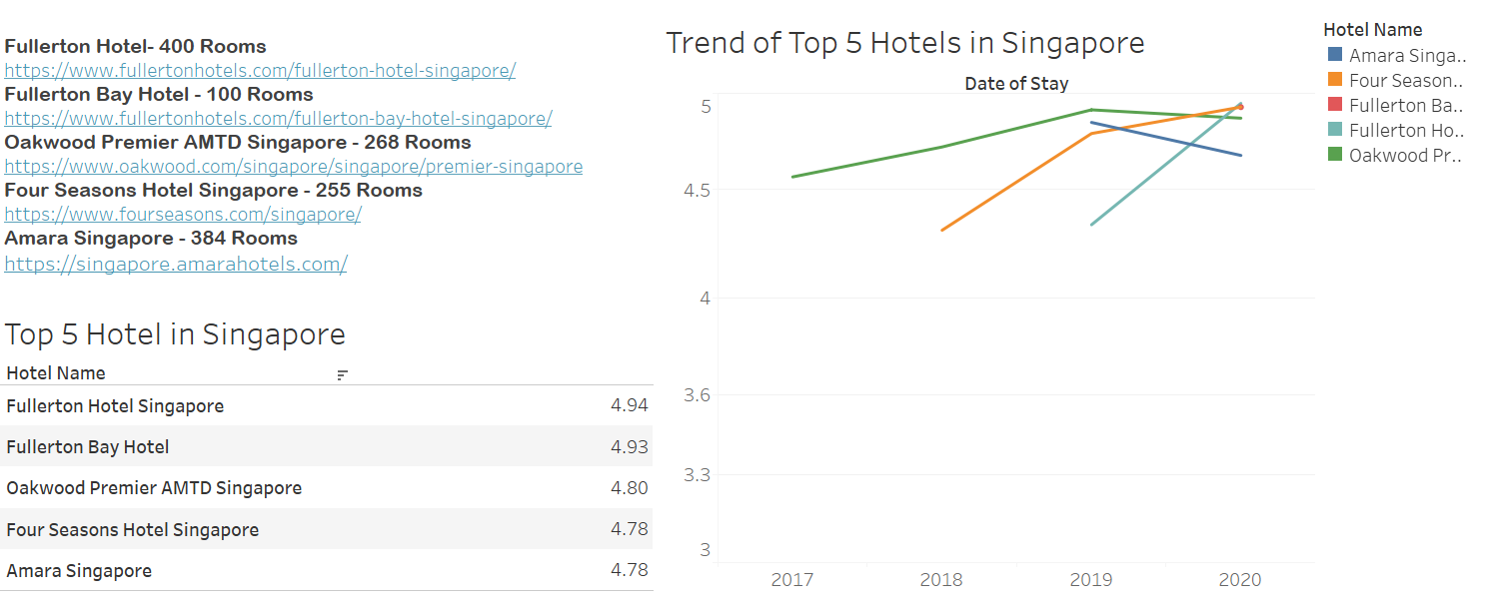
Which hotels are recommended?
Having this Trip Advisor could recommend to the user to choose form one of the top 5 Traveller rated Hotels in Singapore
Having this users will be able to have a shorter time deciding on where to go as they could pick from one of the recommendations

Slide 54
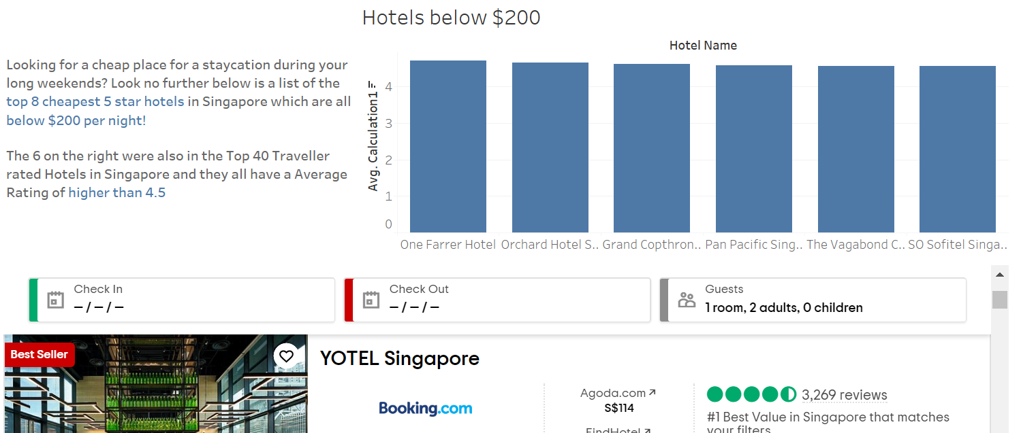
What hotel should we go to for a cheap Staycation?
If the user wanted to go to a Hotel in Singapore for a short Staycation and they had a limited budget they could pick from one of the Hotels here which are below $200 per night.

Slide 55
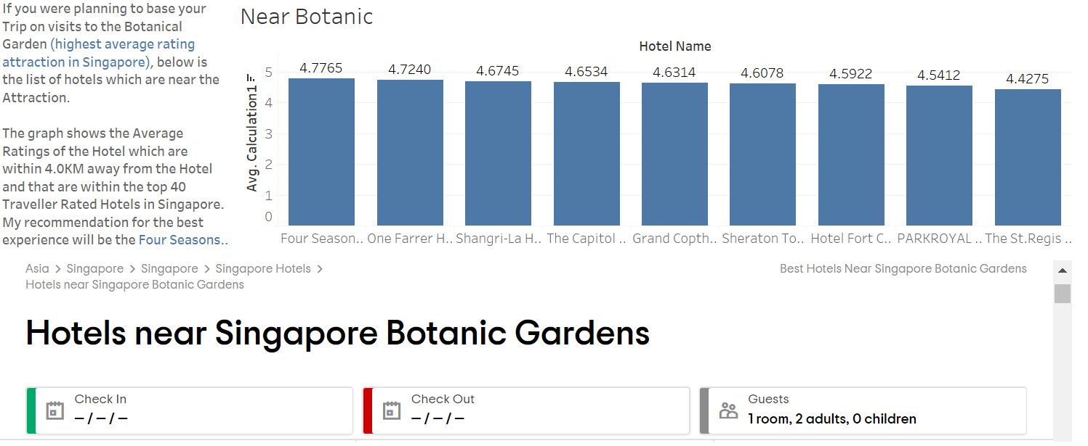
Which hotel should I choose if I wanted to go the best attraction in Singapore?
If they wanted to go to the Best Rated Attraction in Singapore and they wanted to base their trip here on that attraction they could pick out a hotel from the list given

Slide 56
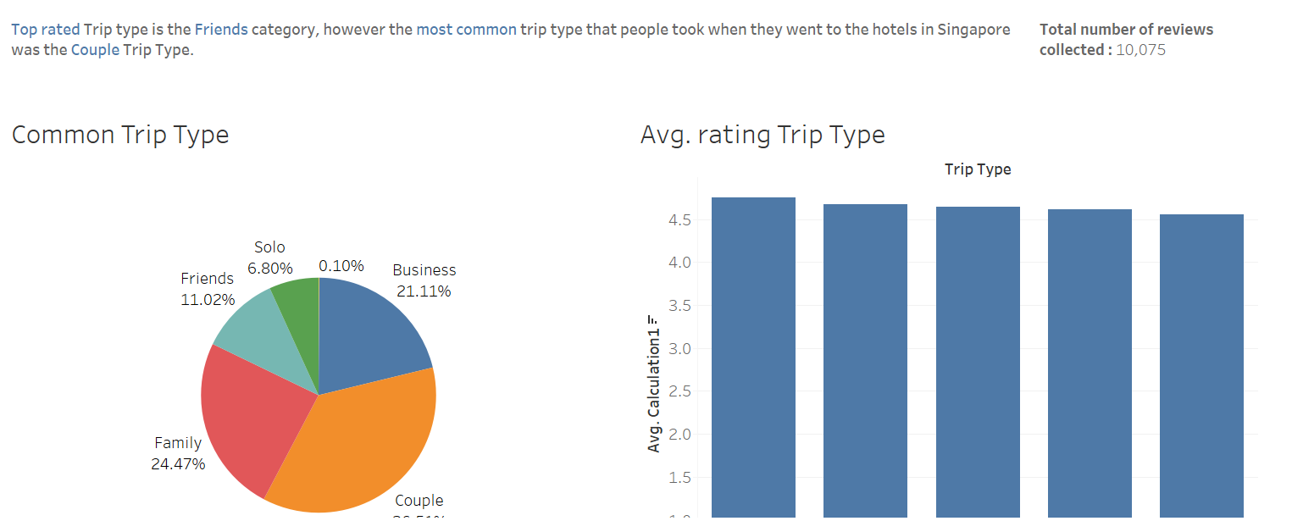
Does the number of visitors affect the rating of the Trip Type?
Currently the most frequently visited trip type on Trip Advisor is the Couple Trip Type but they have the second highest Average Rating whereas the 2nd least visited Trip Type on Trip Advisor is Friends but they have the Highest Average Rating

Slide 57
Attractions Data Set (Syukry)
List of 20 Attractions located in Singapore
10,136 Reviews Scraped from the total number of attractions
Number of pages of reviews ranges from 60 to 250.

Slide 58
List Of Questions (Attractions)
Which Attraction has the highest rating score in the year 2020?
Does ticket price affect footfall for attractions?
Has COVID19 affected Singapore’s attractions?
Will a cluster of attractions have a higher ticket price?
Does ticket price affect enjoyment among visitors?

Slide 59
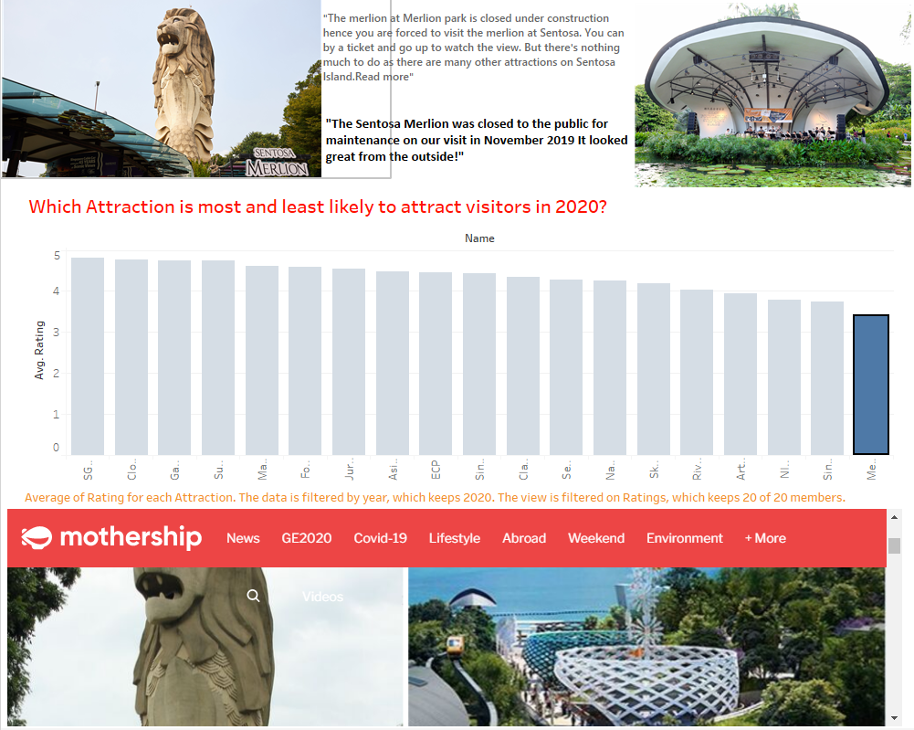
Which Attraction has the highest average rating in the year 2020?

Slide 60
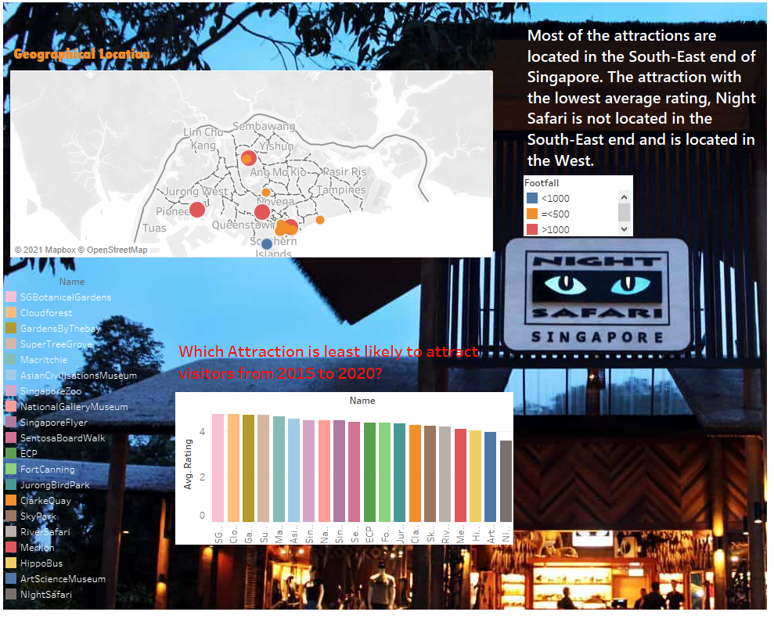
Does ticket price affect footfall for attractions?

Slide 61
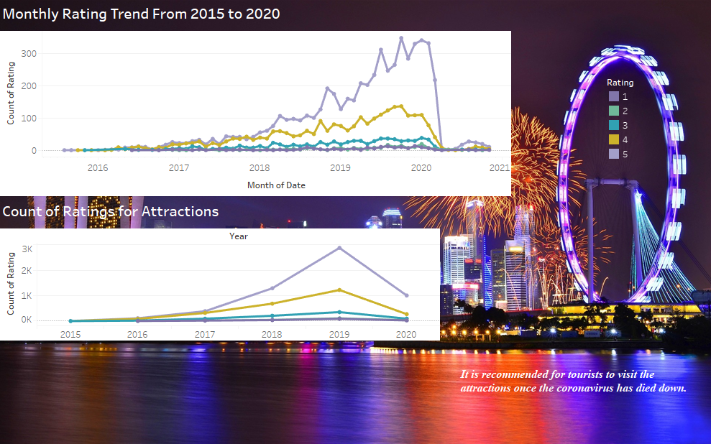

Slide 62
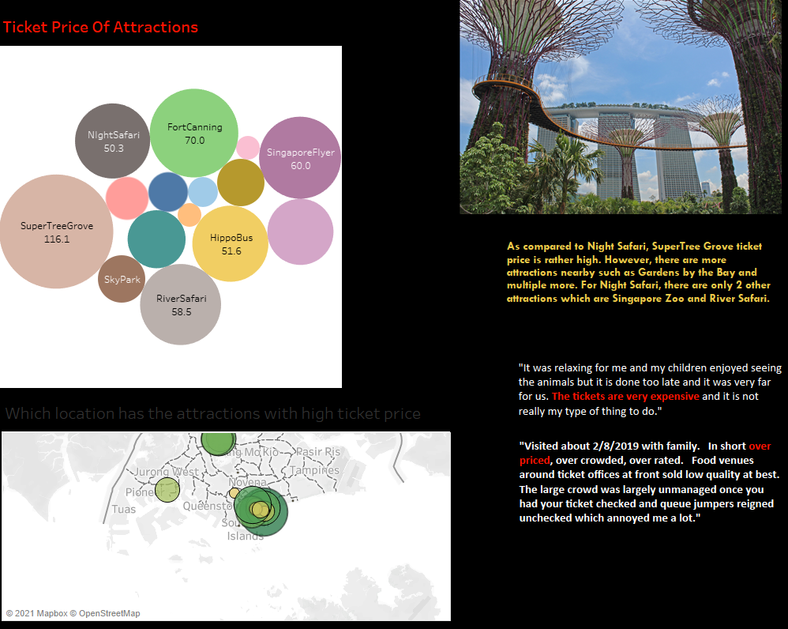

Slide 63
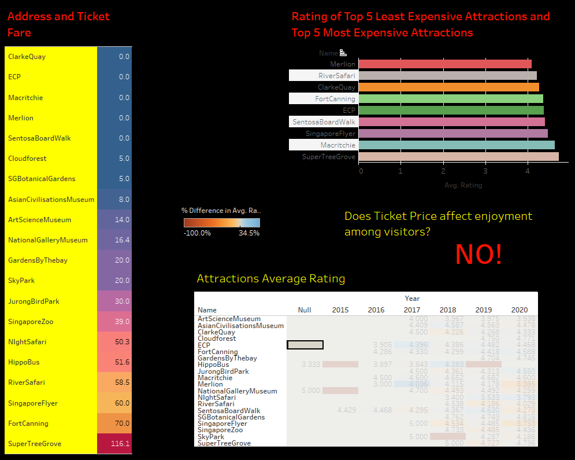

Slide 64


